Slide 1

Panama Electricity Load Forecasting
Group 8
Supervisors: Assoc. Prof. Nguyễn Thị Kim Anh
Prof. Trần Việt Trung
Students:
Tạ Hữu Bình 20190094
Trần Trọng Hiệp 20190051
Nguyễn Văn Trung 20190071
Hà Đức Tuấn 20190072

Slide 2
Contents
Problem
Data
Models
Experiments
Conclusion

Slide 3
Contents
Problem
Data
Models
Experiments
Conclusion

Slide 4
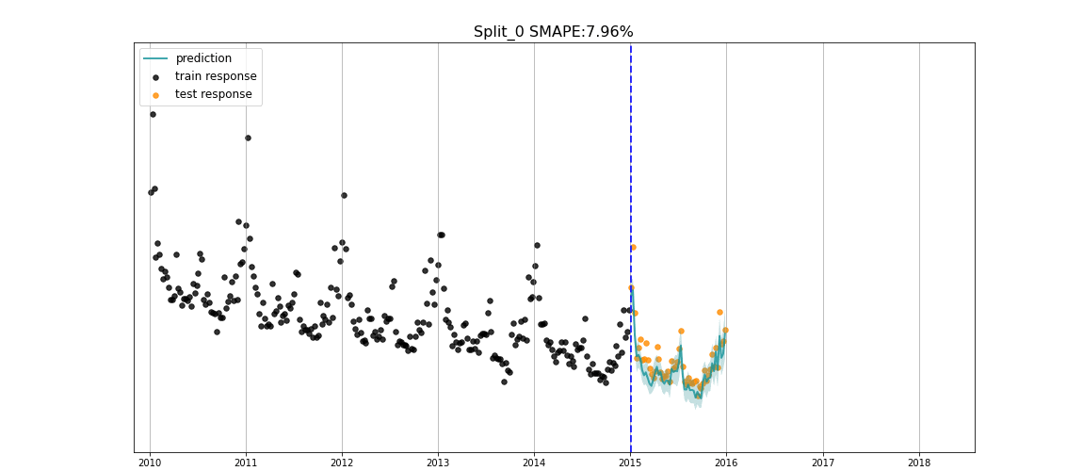
Time series forecasting problem
Electricity load forecasting is a key task for the effective operation and planning of power systems.
Panama Electricity Load Forecasting is a time-series problem to forecast the national electricity load.
The underlying intention of time series forecasting is determining how target variables will change in the future by observing historical data from the time perspective, defining the patterns, and yielding short or long-term
predictions on how
change occurs –
considering the
captured patterns.
Notes:
https://www.iqair.com/world-most-polluted-cities/world-air-quality-report-2021-en.pdf
https://www.weforum.org/agenda/2016/10/air-pollution-facts/
https://www.oecd.org/env/air-pollution-to-cause-6-9-million-premature-deaths-and-cost-1-gdp-by-2060.htm
https://www.stateofglobalair.org/health
https://en.wikipedia.org/wiki/Air_pollution_forecasting
https://agupubs.onlinelibrary.wiley.com/doi/full/10.1002/2017JD028052

Slide 5
Taxonomies
Inputs vs. Outputs
Inputs: history time steps (1h).
Outputs: future time steps (1h).
Endogenous vs. Exogenous
Exogenous: school day, holiday.
Exogenous: others
Regression vs. Classification
Univariate vs. Multivariate
Single-step vs. Multi-step
Contiguous vs. Discontiguous
Notes:
http://www.careourearth.com/wp-content/uploads/2018/02/Real-time-AQI-Visual-Map_Berkeley.jpg
https://www.iqair.com/world-air-quality-ranking
https://www.weforum.org/agenda/2016/10/air-pollution-facts/
https://www.iqair.com/world-most-polluted-cities/world-air-quality-report-2021-en.pdf
https://www.careourearth.com/real-time-air-quality-index-visual-map-excellent/
https://www.orfonline.org/expert-speak/taking-on-a-burning-problem-mumbais-air-pollution/

Slide 6
Contents
Problem
Data
Models
Experiments
Conclusion

Slide 7
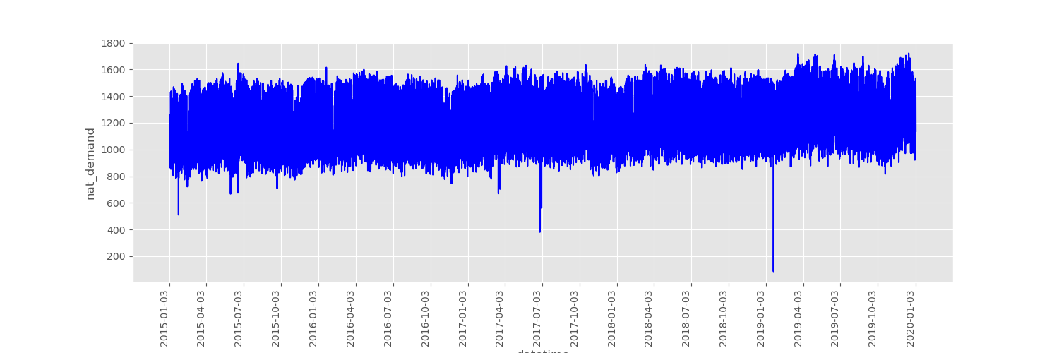
Panama Electric Load dataset
Source: Kaggle https://www.kaggle.com/datasets/pateljay731/panama-electricity-load-forecasting
Forecast national electricity load.
Number of variables measured to forecast: 14
Notes:
http://www.careourearth.com/wp-content/uploads/2018/02/Real-time-AQI-Visual-Map_Berkeley.jpg
https://www.iqair.com/world-air-quality-ranking
https://www.weforum.org/agenda/2016/10/air-pollution-facts/
https://www.iqair.com/world-most-polluted-cities/world-air-quality-report-2021-en.pdf
https://www.careourearth.com/real-time-air-quality-index-visual-map-excellent/
https://www.orfonline.org/expert-speak/taking-on-a-burning-problem-mumbais-air-pollution/

Slide 8
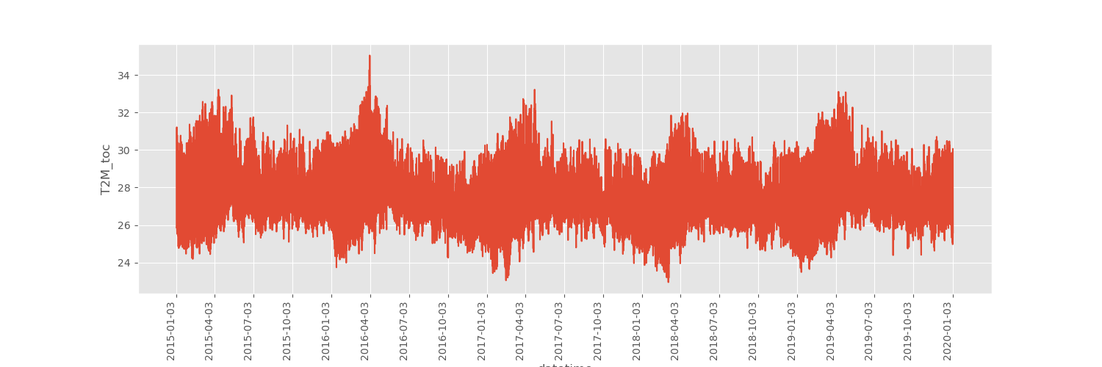
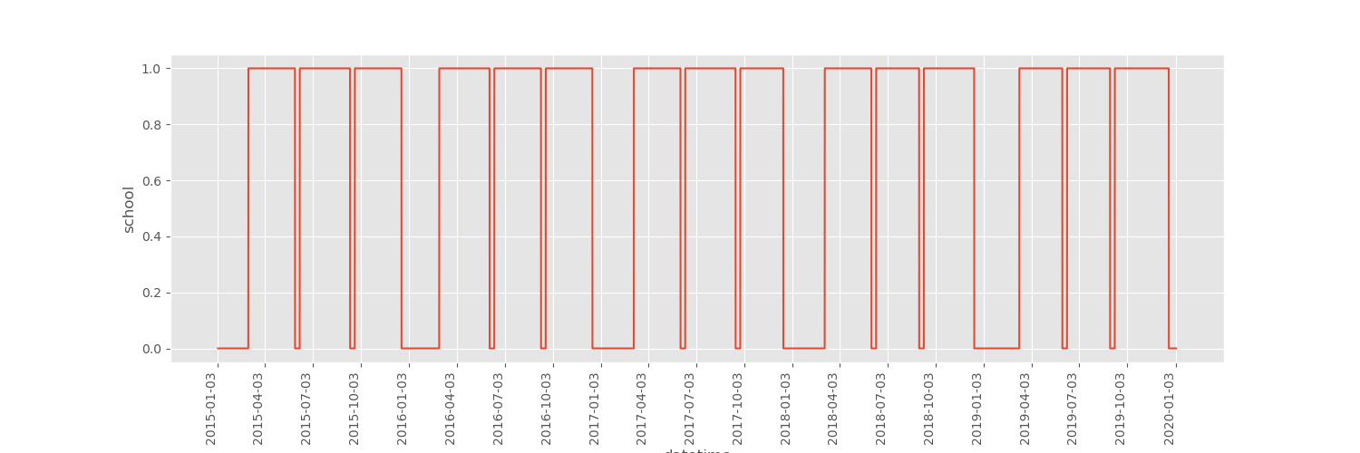
Temperature and school day through time
Notes:
http://www.careourearth.com/wp-content/uploads/2018/02/Real-time-AQI-Visual-Map_Berkeley.jpg
https://www.iqair.com/world-air-quality-ranking
https://www.weforum.org/agenda/2016/10/air-pollution-facts/
https://www.iqair.com/world-most-polluted-cities/world-air-quality-report-2021-en.pdf
https://www.careourearth.com/real-time-air-quality-index-visual-map-excellent/
https://www.orfonline.org/expert-speak/taking-on-a-burning-problem-mumbais-air-pollution/

Slide 9
Contents
Problem
Data
Models
Conventional approaches
Deep Learning approaches
Experiments
Conclusion

Slide 10
Vector autoregression (VAR)
A statistical model for multivariate time series analysis
Models relationships between variables over time
Forecasts future values by capturing complex relationships
Can be applied to multiple types of data
Pros: captures complex relationships, versatile
Cons: computationally expensive, struggles with long-term dependencies, prone to overfitting.
Notes:
http://www.careourearth.com/wp-content/uploads/2018/02/Real-time-AQI-Visual-Map_Berkeley.jpg
https://www.iqair.com/world-air-quality-ranking
https://www.weforum.org/agenda/2016/10/air-pollution-facts/
https://www.iqair.com/world-most-polluted-cities/world-air-quality-report-2021-en.pdf
https://www.careourearth.com/real-time-air-quality-index-visual-map-excellent/
https://www.orfonline.org/expert-speak/taking-on-a-burning-problem-mumbais-air-pollution/

Slide 11

Facebook Prophet (FbProphet)
Prophet is a time series forecasting library developed by Facebook.
It is designed for analyzing time series data that has multiple seasons and trends, making it suitable for a wide range of applications such as predicting sales, website traffic, and stock prices.
Pros
Ease of Use
Flexibility
Speed
Cons
Limited Modeling Capabilities
Lack of Customization
Limited Handling of Exogenous Variables
Notes:
http://www.careourearth.com/wp-content/uploads/2018/02/Real-time-AQI-Visual-Map_Berkeley.jpg
https://www.iqair.com/world-air-quality-ranking
https://www.weforum.org/agenda/2016/10/air-pollution-facts/
https://www.iqair.com/world-most-polluted-cities/world-air-quality-report-2021-en.pdf
https://www.careourearth.com/real-time-air-quality-index-visual-map-excellent/
https://www.orfonline.org/expert-speak/taking-on-a-burning-problem-mumbais-air-pollution/

Slide 12

Recurrent neural network (RNN)
RNN for sequential data processing.
Maintains past information for future predictions.
Ideal for NLP, speech recognition, and time series prediction.
Handles dependencies in sequences.
Effective in modeling complex relationships in sequential data.
Notes:
http://www.careourearth.com/wp-content/uploads/2018/02/Real-time-AQI-Visual-Map_Berkeley.jpg
https://www.iqair.com/world-air-quality-ranking
https://www.weforum.org/agenda/2016/10/air-pollution-facts/
https://www.iqair.com/world-most-polluted-cities/world-air-quality-report-2021-en.pdf
https://www.careourearth.com/real-time-air-quality-index-visual-map-excellent/
https://www.orfonline.org/expert-speak/taking-on-a-burning-problem-mumbais-air-pollution/

Slide 13
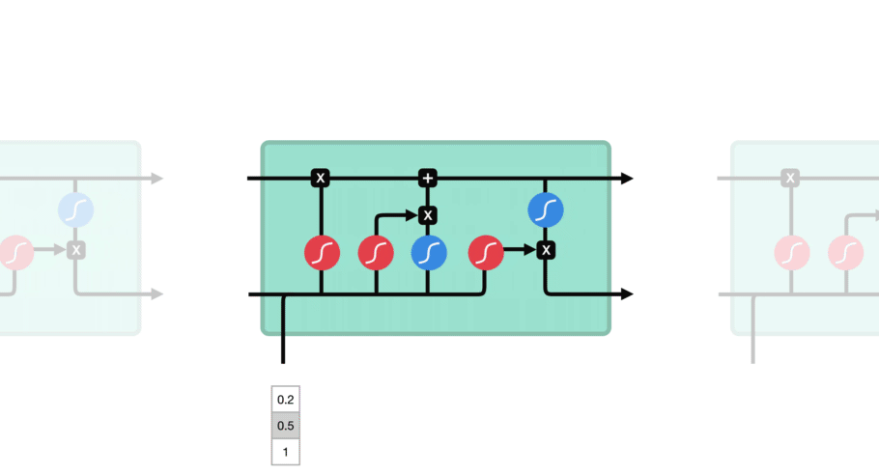
Long-short term memory (LSTM)
RNN architecture
Pros
Ability to handle long-term dependencies
Solves vanishing gradient problem
Versatility: applied to a wide range of tasks, such as time series
Cons
Computationally expensive
Hyperparameter tuning
Complexity
Notes:
http://www.careourearth.com/wp-content/uploads/2018/02/Real-time-AQI-Visual-Map_Berkeley.jpg
https://www.iqair.com/world-air-quality-ranking
https://www.weforum.org/agenda/2016/10/air-pollution-facts/
https://www.iqair.com/world-most-polluted-cities/world-air-quality-report-2021-en.pdf
https://www.careourearth.com/real-time-air-quality-index-visual-map-excellent/
https://www.orfonline.org/expert-speak/taking-on-a-burning-problem-mumbais-air-pollution/

Slide 14
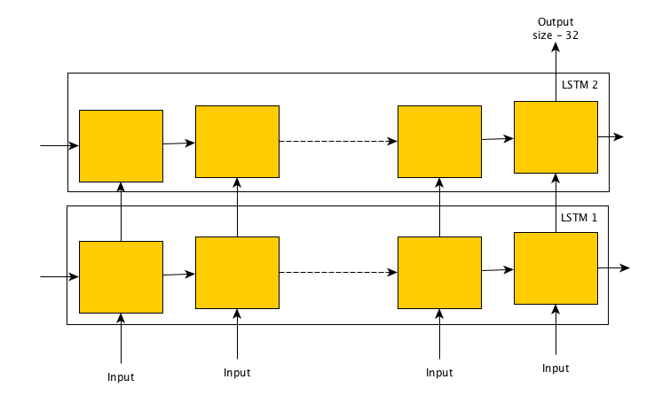
Stacked LSTM
Mutiple layers of LSTM
Better suited for tasks modeling complex relationship
Compared to LSTM:
Pros
Improved capacity
Improved generalization
Better capture of long-term dependencies
Cons
Increased complexity
Increased computational cost
Notes:
Pros:
Increased capacity: Stacking LSTM layers increases the capacity of the network and allows it to model more complex relationships in sequential data. This can lead to improved performance on tasks such as language modeling and speech recognition.
Hierarchical representation: The output from one layer can be used as the input to the next layer, allowing for a hierarchical representation of the data that can capture deeper relationships.
Improved generalization: Stacked LSTMs have been shown to have better generalization performance compared to single-layer LSTMs, meaning they are less likely to overfit to the training data.
Better capture of long-term dependencies: By stacking multiple layers of LSTM cells, Stacked LSTMs are better able to maintain information from long sequences, making them ideal for tasks where long-term dependencies are important.
Cons:
Disadvantages of Stacked LSTMs compared to traditional LSTMs:
Increased complexity: Stacked LSTMs are more complex than traditional LSTMs, making them more difficult to implement and debug.
Increased computational cost: Stacked LSTMs are more computationally expensive than traditional LSTMs, requiring more computational resources to train and run

Slide 15
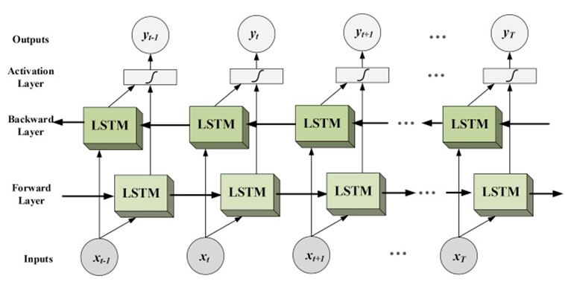
Bidirectional LSTM
Consists of two LSTM layers
One forward processing and one backward processing
Good choice for tasks where capturing context is important
Compared to Stacked LSTM:
Pros
Ability to capture context: both past and future state
Cons: with task requires complex relationships
Limited capacity
Reduced performance
15
Notes:
http://www.careourearth.com/wp-content/uploads/2018/02/Real-time-AQI-Visual-Map_Berkeley.jpg
https://www.iqair.com/world-air-quality-ranking
https://www.weforum.org/agenda/2016/10/air-pollution-facts/
https://www.iqair.com/world-most-polluted-cities/world-air-quality-report-2021-en.pdf
https://www.careourearth.com/real-time-air-quality-index-visual-map-excellent/
https://www.orfonline.org/expert-speak/taking-on-a-burning-problem-mumbais-air-pollution/

Slide 16
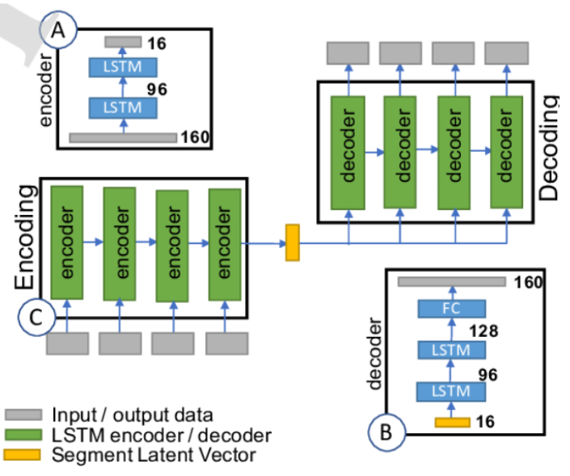
Auto-encoder LSTM
Auto-encoder LSTM is an implementation of an Auto-encoder for sequence data using an Encoder-Decoder LSTM architecture.
An encoder-decoder LSTM is trained on a dataset of sequences to read, encode, decode and recreate the input sequence.
Compared to Stacked LSTM:
Pros
Data compression
Dimensionality Reduction
Cons
Complexity
Limited Applications
Notes:
Pros:
Increased capacity: Stacking LSTM layers increases the capacity of the network and allows it to model more complex relationships in sequential data. This can lead to improved performance on tasks such as language modeling and speech recognition.
Hierarchical representation: The output from one layer can be used as the input to the next layer, allowing for a hierarchical representation of the data that can capture deeper relationships.
Improved generalization: Stacked LSTMs have been shown to have better generalization performance compared to single-layer LSTMs, meaning they are less likely to overfit to the training data.
Better capture of long-term dependencies: By stacking multiple layers of LSTM cells, Stacked LSTMs are better able to maintain information from long sequences, making them ideal for tasks where long-term dependencies are important.
Cons:
Computationally expensive: Stacked LSTMs can be computationally expensive, making training large models difficult and time-consuming.
Hyperparameter tuning: Stacked LSTMs have many hyperparameters that need to be carefully tuned in order to achieve good performance, which can be a challenge for inexperienced users.
Overfitting: Stacked LSTMs have a higher capacity than single-layer LSTMs, which can lead to overfitting if not properly regularized.
Increased complexity: Stacked LSTMs are more complex than single-layer LSTMs, making it harder for new users to get started with the model.

Slide 17
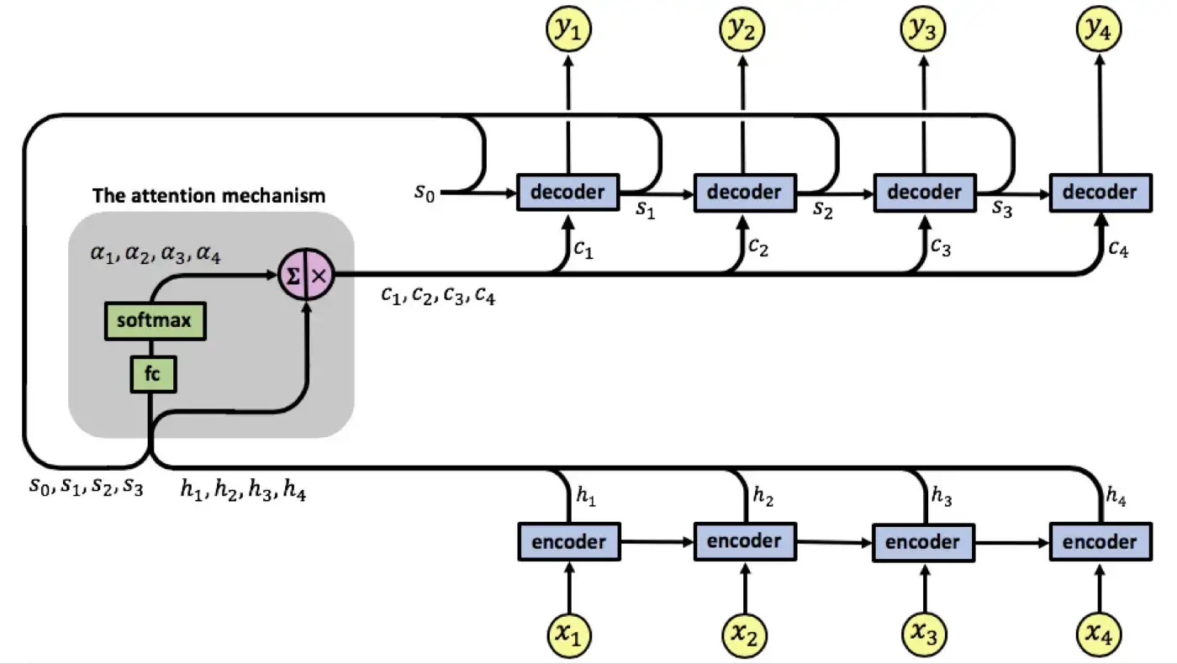
Attention Mechanism in LSTM
A technique for selectively focusing on certain parts of the input sequence while making predictions
Unlike traditional LSTMs, which treat all input steps equally, attention allows the model to weigh different steps differently, based on their relevance to the prediction task.
Improved accuracy and increased interpretability
Notes:
Pros:
Increased capacity: Stacking LSTM layers increases the capacity of the network and allows it to model more complex relationships in sequential data. This can lead to improved performance on tasks such as language modeling and speech recognition.
Hierarchical representation: The output from one layer can be used as the input to the next layer, allowing for a hierarchical representation of the data that can capture deeper relationships.
Improved generalization: Stacked LSTMs have been shown to have better generalization performance compared to single-layer LSTMs, meaning they are less likely to overfit to the training data.
Better capture of long-term dependencies: By stacking multiple layers of LSTM cells, Stacked LSTMs are better able to maintain information from long sequences, making them ideal for tasks where long-term dependencies are important.
Cons:
Computationally expensive: Stacked LSTMs can be computationally expensive, making training large models difficult and time-consuming.
Hyperparameter tuning: Stacked LSTMs have many hyperparameters that need to be carefully tuned in order to achieve good performance, which can be a challenge for inexperienced users.
Overfitting: Stacked LSTMs have a higher capacity than single-layer LSTMs, which can lead to overfitting if not properly regularized.
Increased complexity: Stacked LSTMs are more complex than single-layer LSTMs, making it harder for new users to get started with the model.

Slide 18
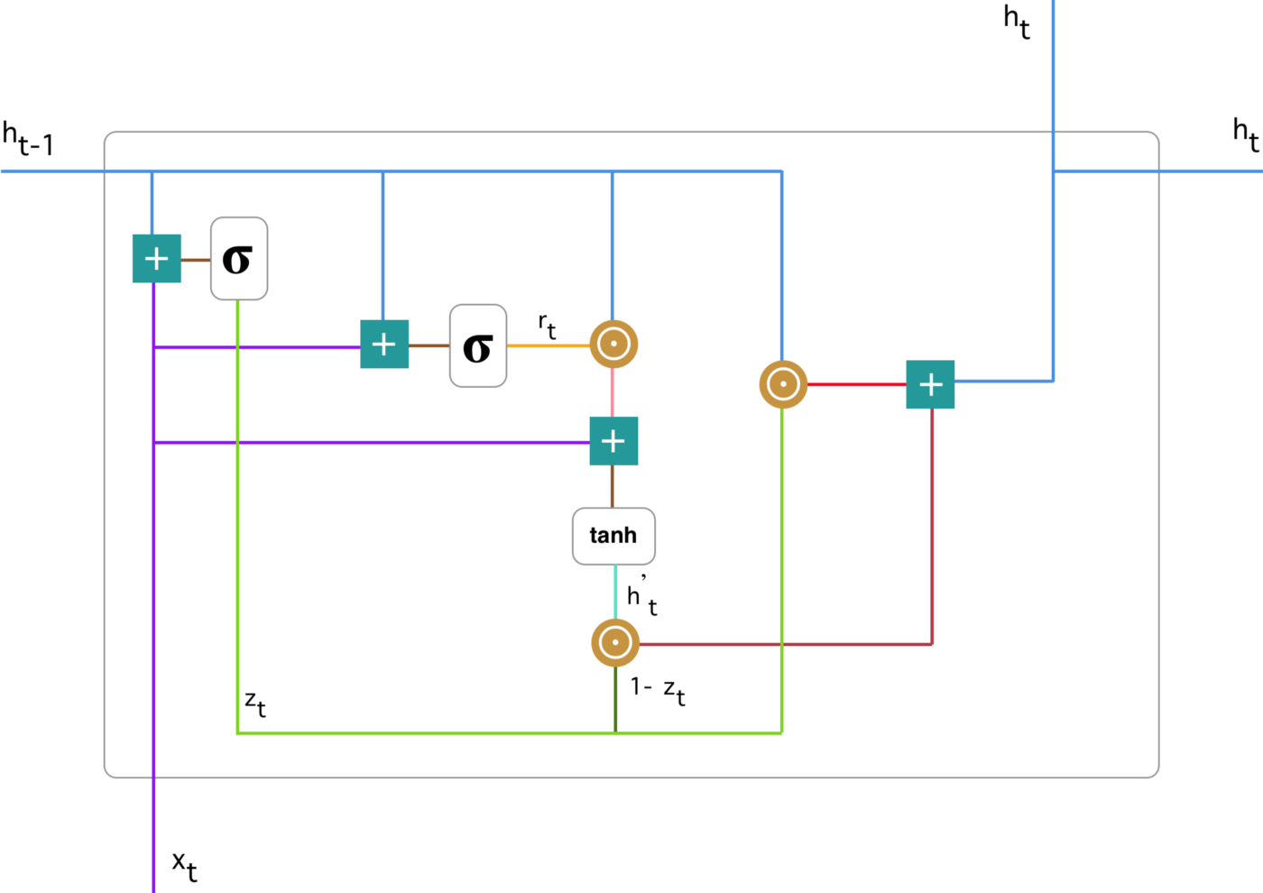
Gate Recurrent Unit (GRU)
GRU (Gated Recurrent Unit) is a type of RNN designed to handle long-term dependencies in sequential data.
Uses two gates (update and reset) to control information flow, improving computational efficiency and reducing vanishing gradient issues.
Widely used in NLP, language translation, text classification, and speech recognition
Notes:
http://www.careourearth.com/wp-content/uploads/2018/02/Real-time-AQI-Visual-Map_Berkeley.jpg
https://www.iqair.com/world-air-quality-ranking
https://www.weforum.org/agenda/2016/10/air-pollution-facts/
https://www.iqair.com/world-most-polluted-cities/world-air-quality-report-2021-en.pdf
https://www.careourearth.com/real-time-air-quality-index-visual-map-excellent/
https://www.orfonline.org/expert-speak/taking-on-a-burning-problem-mumbais-air-pollution/

Slide 19
Contents
Problem
Data
Models
Experiments
Experimental settings
VAR and Prophet
Deep Learning
Conclusion

Slide 20
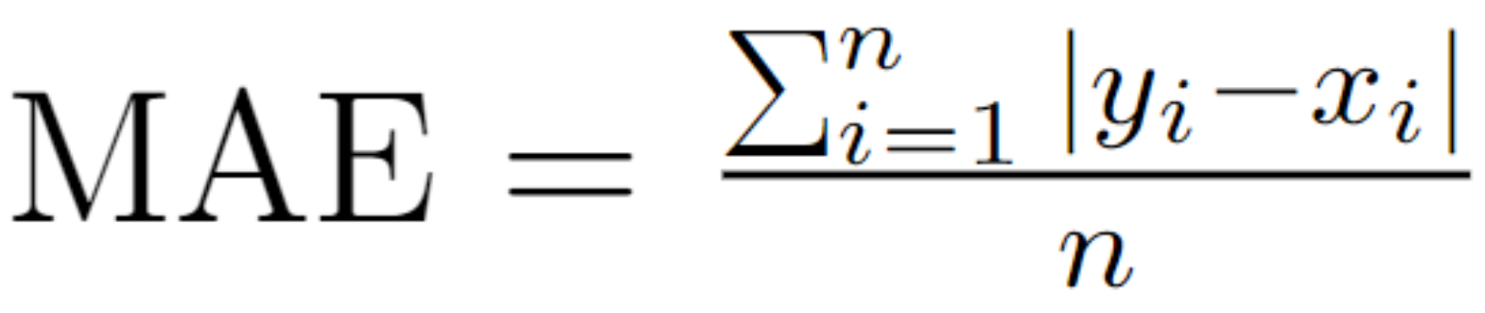
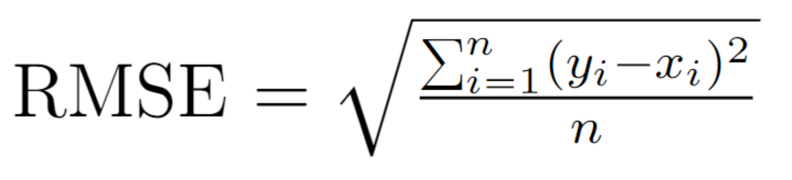
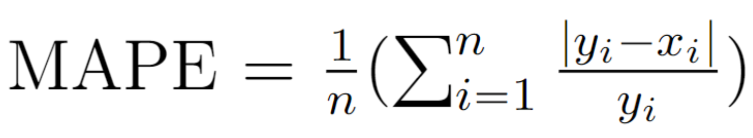
Experimental settings
Loss:
Models:
VAR
FbProphet
LSTM and its variants
GRU
Notes:
http://www.careourearth.com/wp-content/uploads/2018/02/Real-time-AQI-Visual-Map_Berkeley.jpg
https://www.iqair.com/world-air-quality-ranking
https://www.weforum.org/agenda/2016/10/air-pollution-facts/
https://www.iqair.com/world-most-polluted-cities/world-air-quality-report-2021-en.pdf
https://www.careourearth.com/real-time-air-quality-index-visual-map-excellent/
https://www.orfonline.org/expert-speak/taking-on-a-burning-problem-mumbais-air-pollution/

Slide 21
Test scenarios
Measure the performance of two traditional approaches → Benchmarks.
Impact of history on the performance of Deep Learning models → Find proper number of history time steps.
Usefulness of clipping techniques → Whether the abnormally low value of the National electricity load cause negative effect.
Performance of models when forecasting different number of future time steps → When Deep Learning models helpful.
Test the endurance → Can models perform well without retraing.
Notes:
http://www.careourearth.com/wp-content/uploads/2018/02/Real-time-AQI-Visual-Map_Berkeley.jpg
https://www.iqair.com/world-air-quality-ranking
https://www.weforum.org/agenda/2016/10/air-pollution-facts/
https://www.iqair.com/world-most-polluted-cities/world-air-quality-report-2021-en.pdf
https://www.careourearth.com/real-time-air-quality-index-visual-map-excellent/
https://www.orfonline.org/expert-speak/taking-on-a-burning-problem-mumbais-air-pollution/

Slide 22
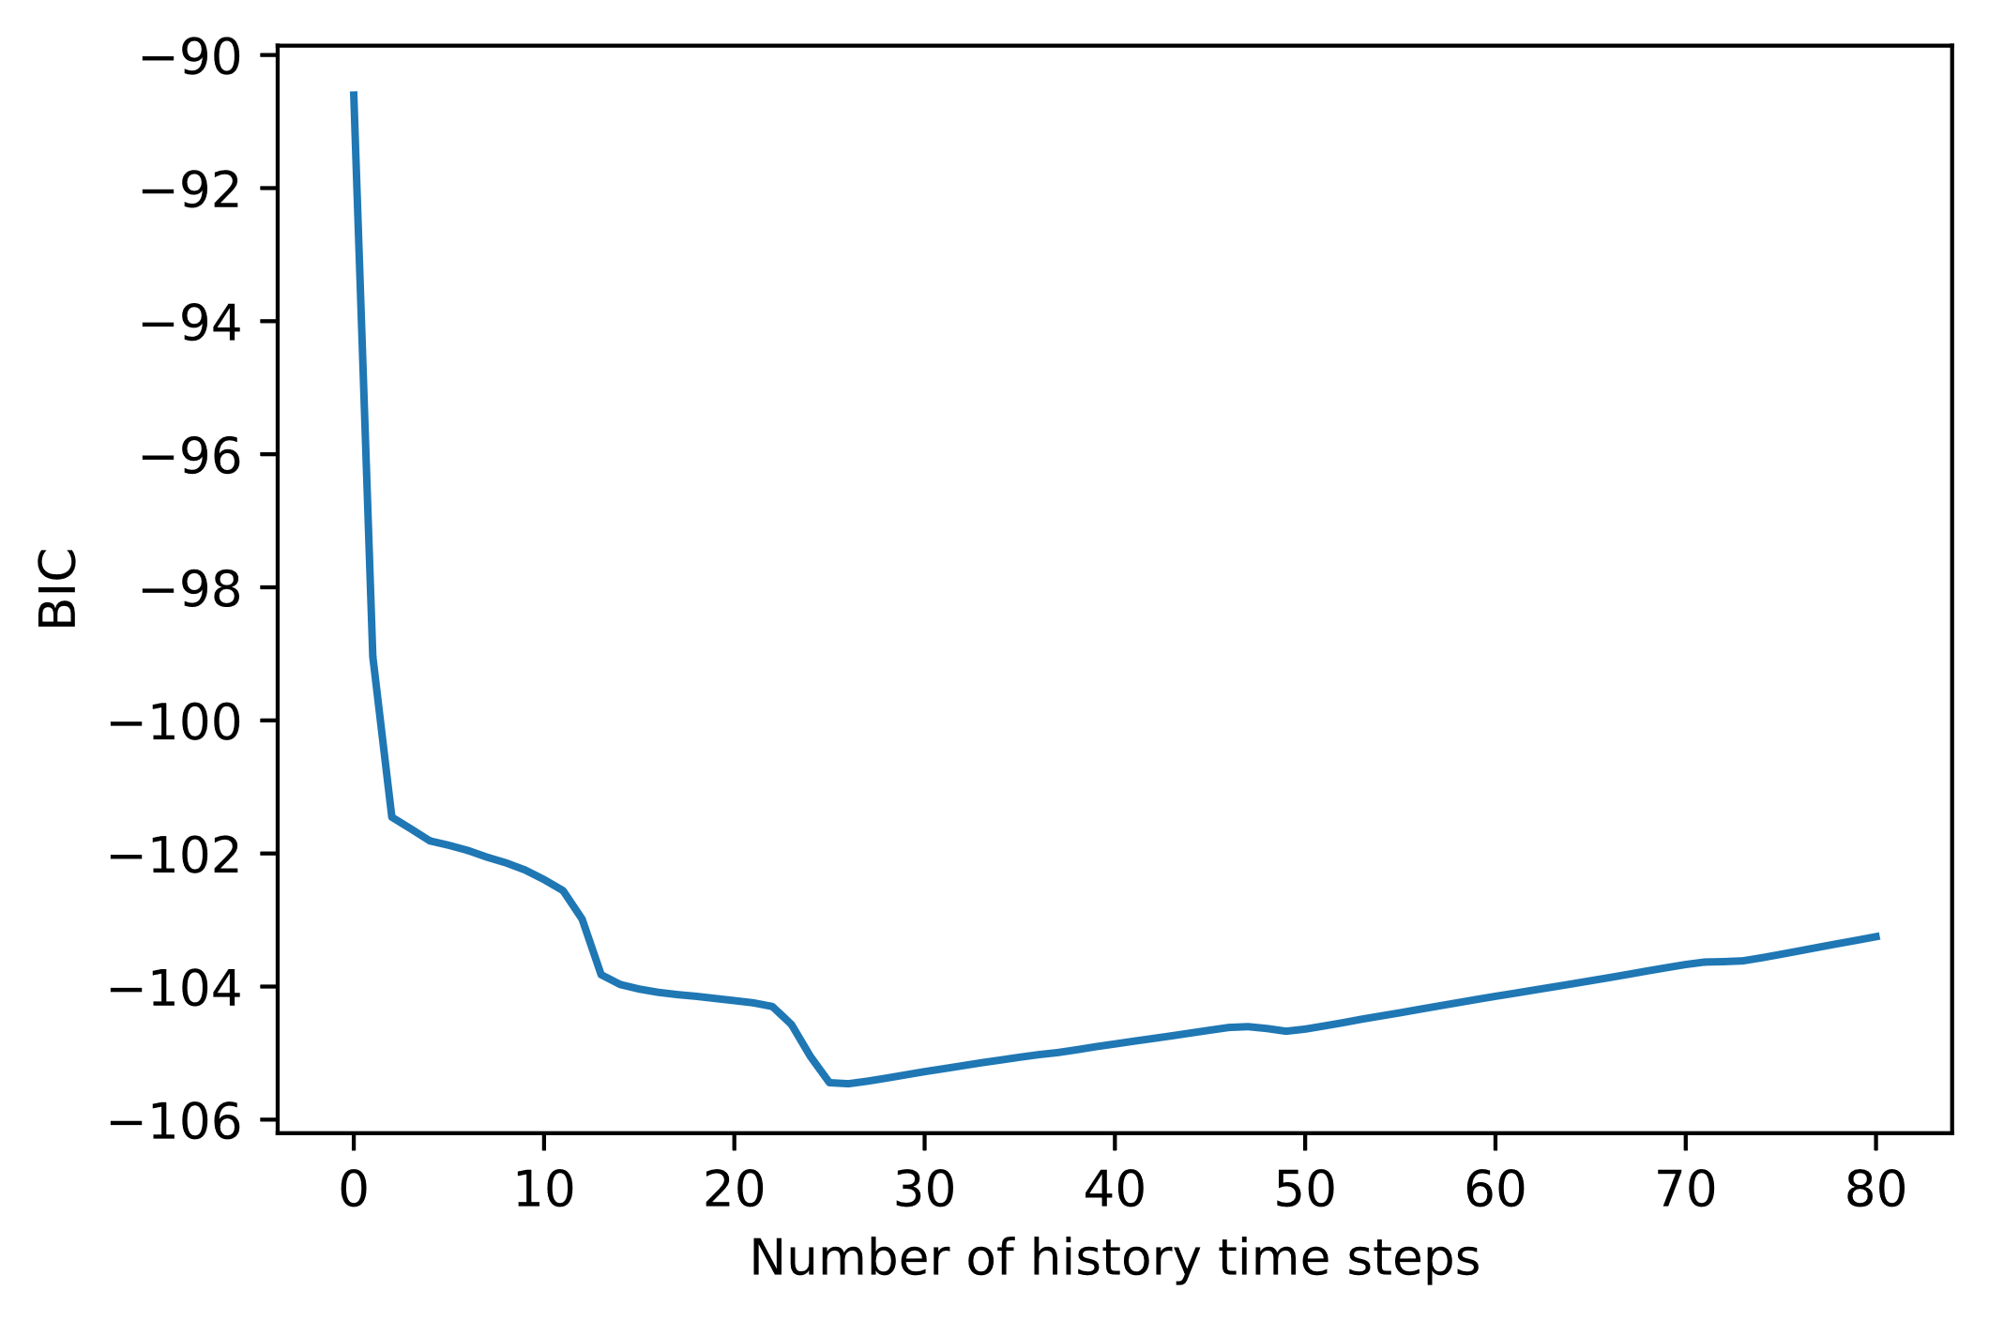
VAR - Bayesian Information Criterion
Best order (number of history time steps used to predict) is 26.
Notes:
http://www.careourearth.com/wp-content/uploads/2018/02/Real-time-AQI-Visual-Map_Berkeley.jpg
https://www.iqair.com/world-air-quality-ranking
https://www.weforum.org/agenda/2016/10/air-pollution-facts/
https://www.iqair.com/world-most-polluted-cities/world-air-quality-report-2021-en.pdf
https://www.careourearth.com/real-time-air-quality-index-visual-map-excellent/
https://www.orfonline.org/expert-speak/taking-on-a-burning-problem-mumbais-air-pollution/

Slide 23
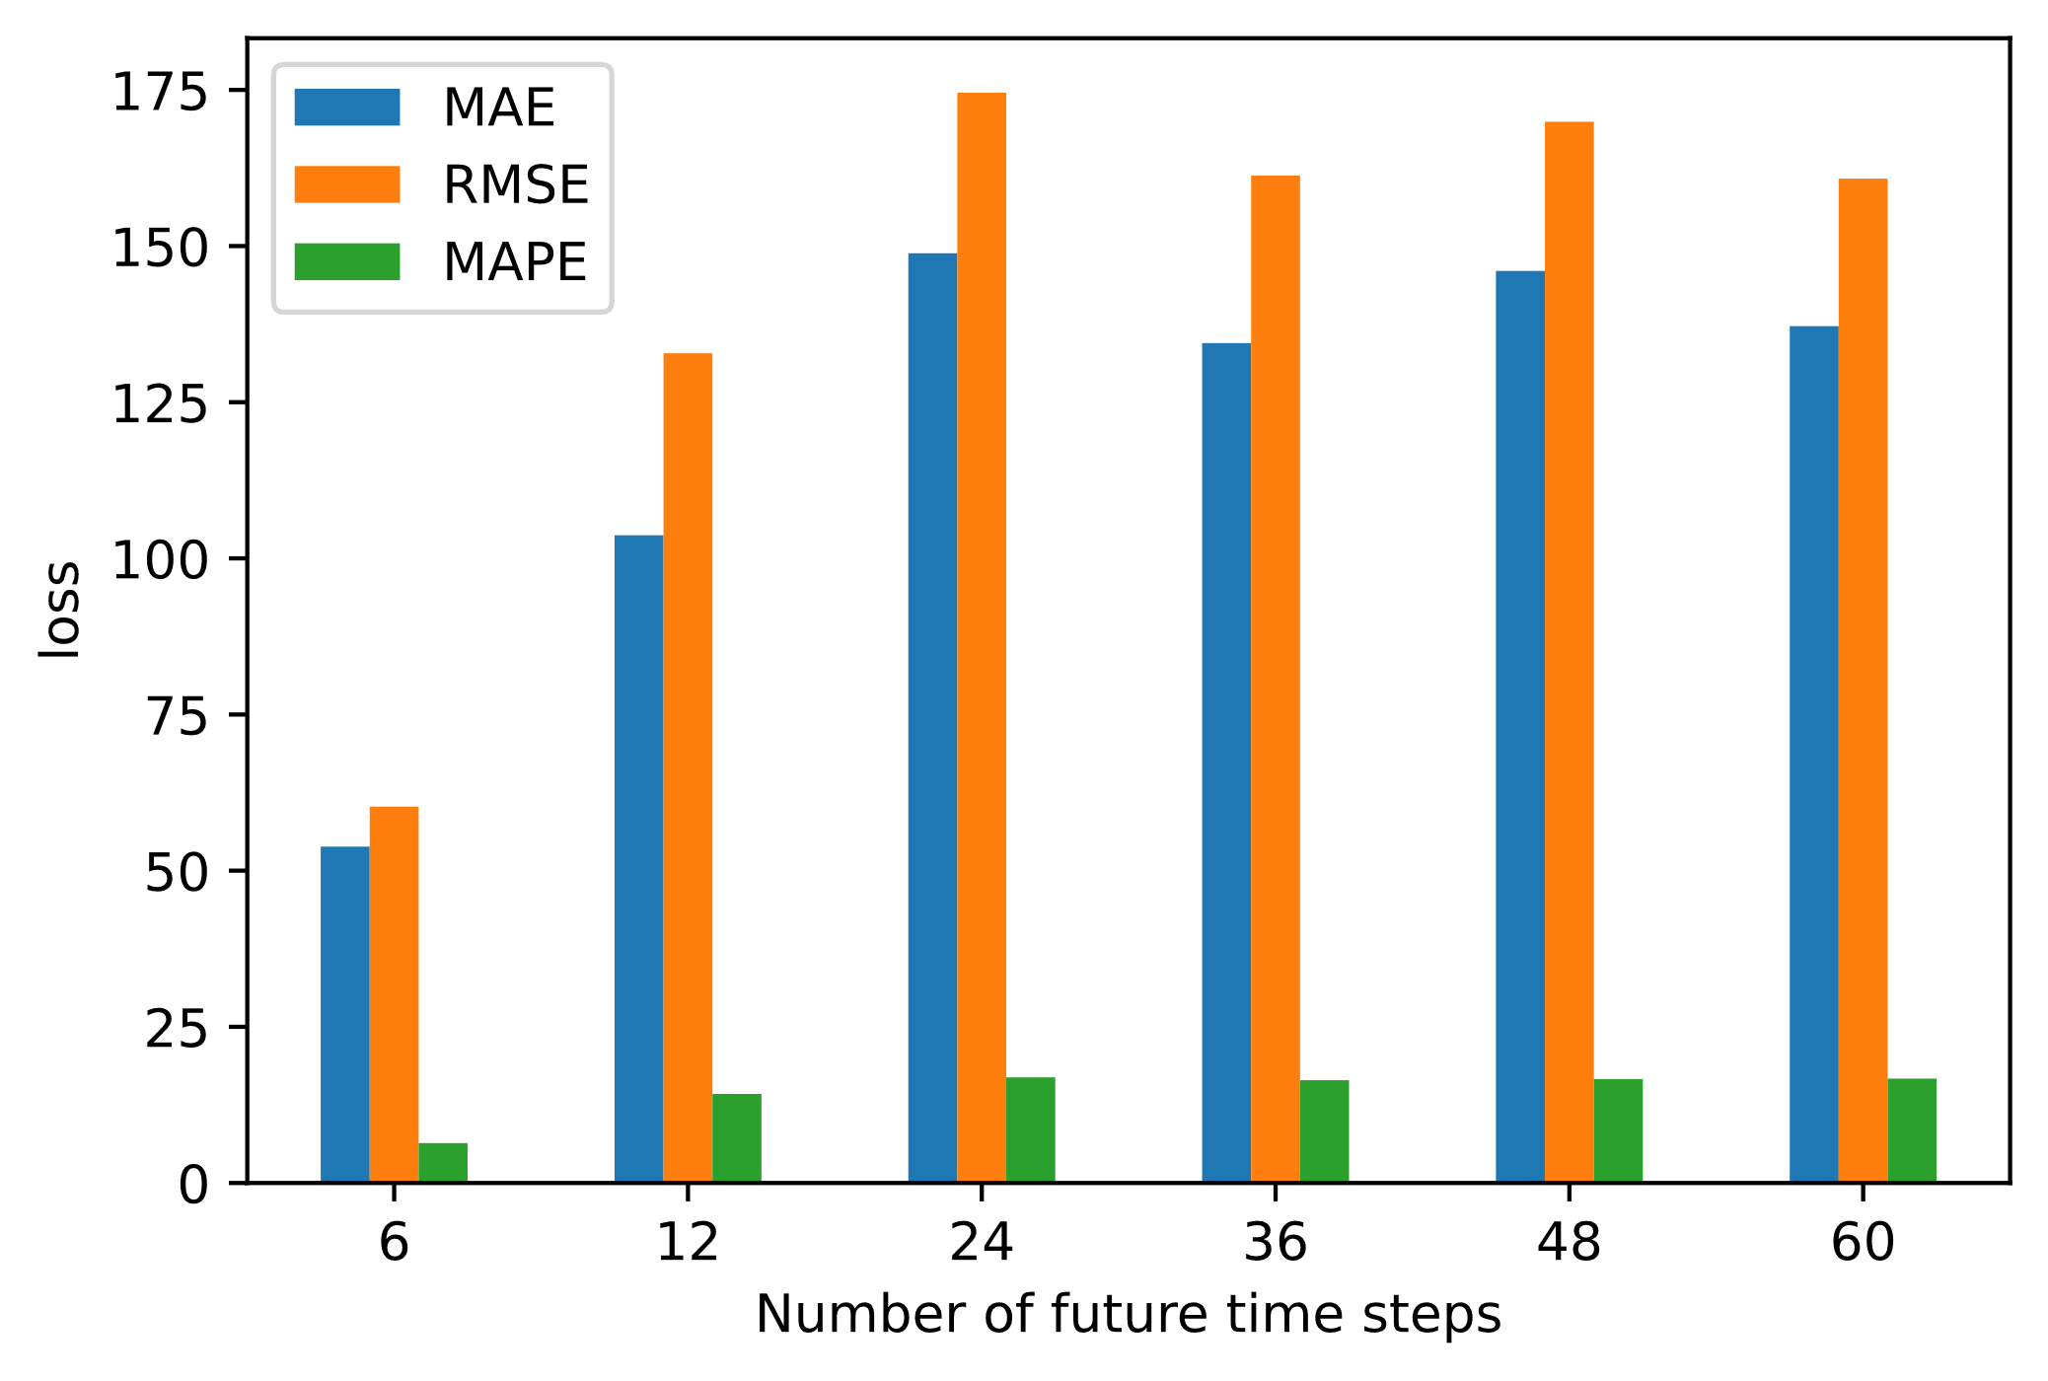
Performance of VAR
Notes:
http://www.careourearth.com/wp-content/uploads/2018/02/Real-time-AQI-Visual-Map_Berkeley.jpg
https://www.iqair.com/world-air-quality-ranking
https://www.weforum.org/agenda/2016/10/air-pollution-facts/
https://www.iqair.com/world-most-polluted-cities/world-air-quality-report-2021-en.pdf
https://www.careourearth.com/real-time-air-quality-index-visual-map-excellent/
https://www.orfonline.org/expert-speak/taking-on-a-burning-problem-mumbais-air-pollution/

Slide 24
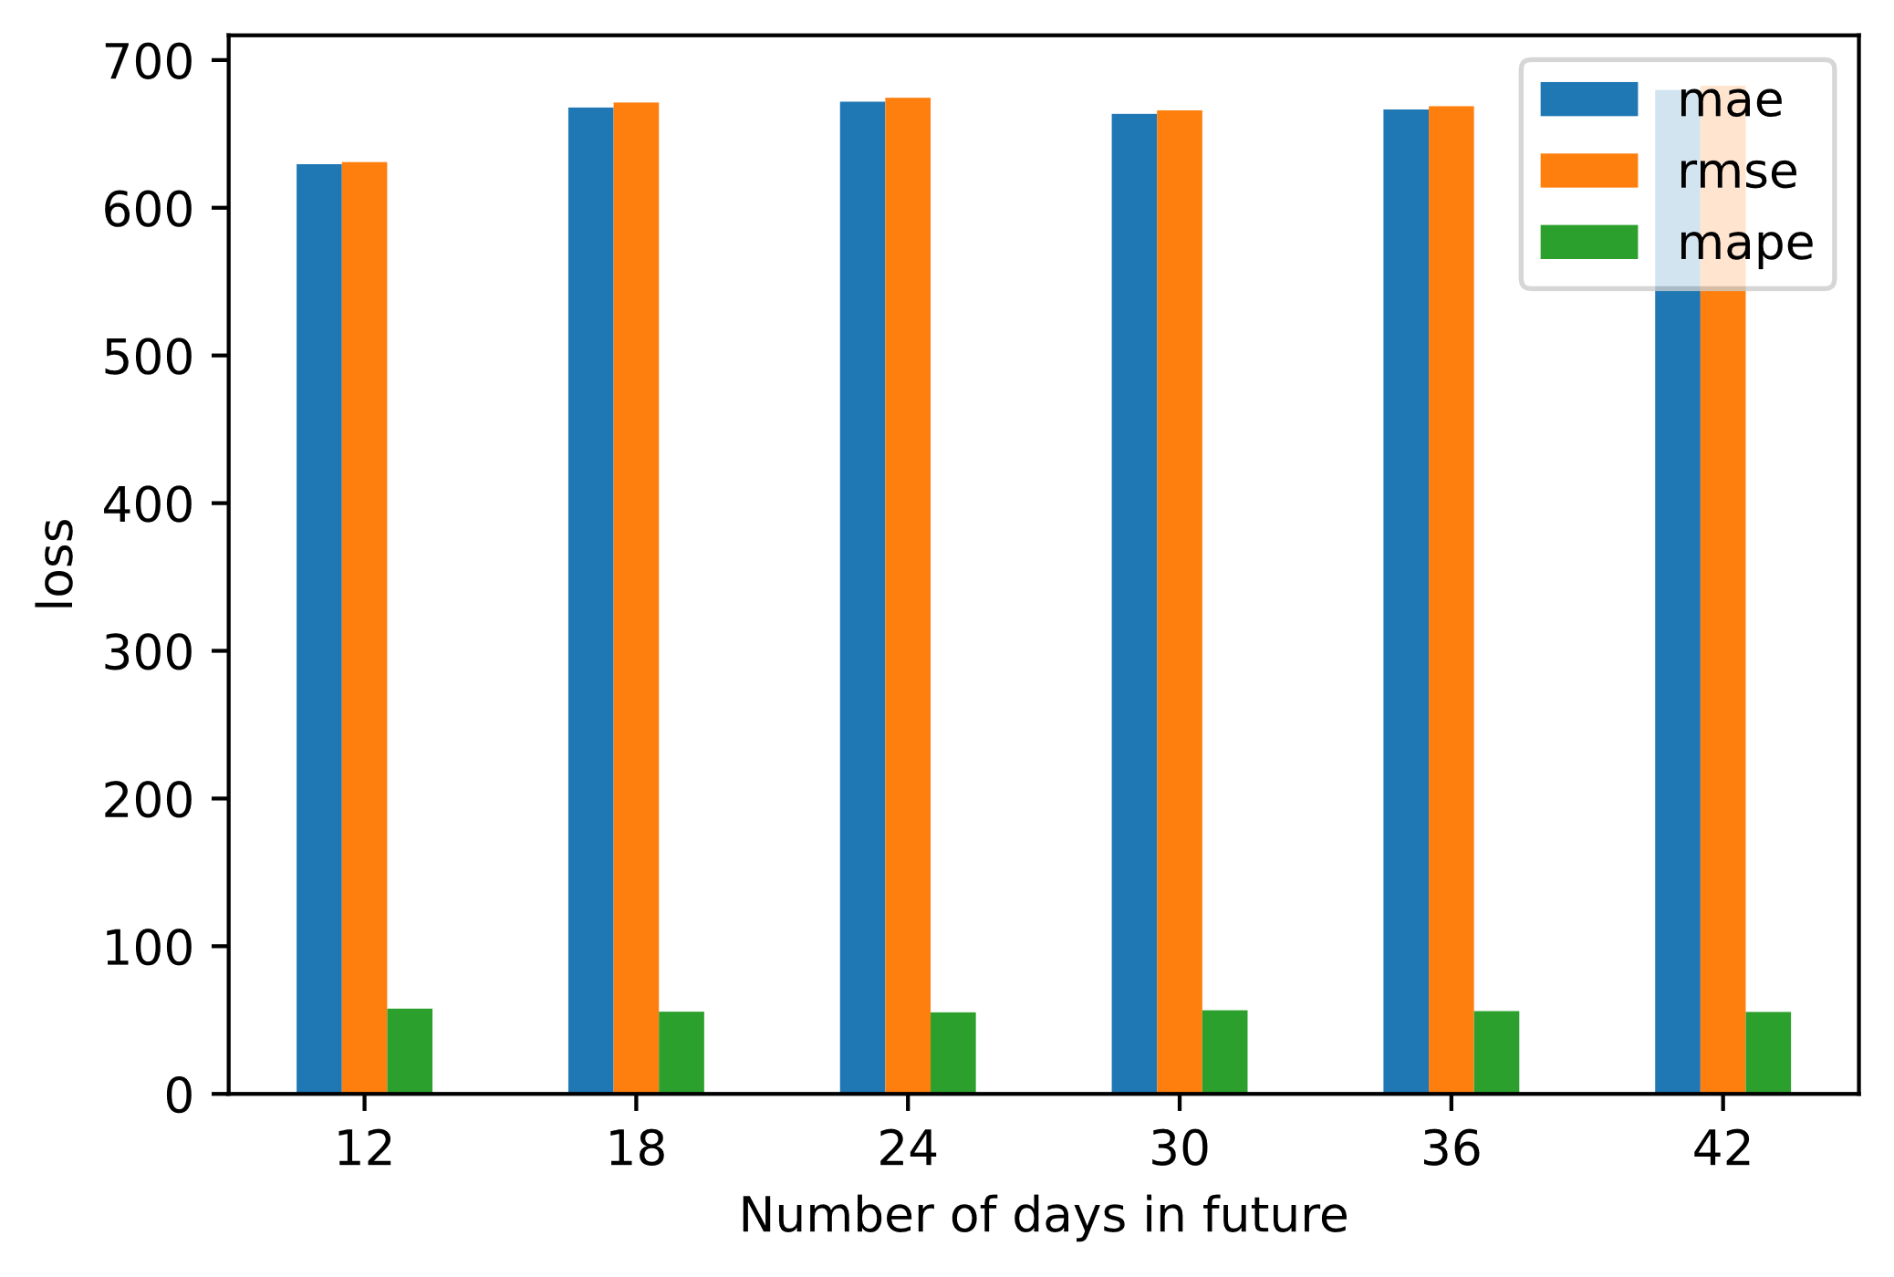
Performance of Facebook Prophet
Notes:
http://www.careourearth.com/wp-content/uploads/2018/02/Real-time-AQI-Visual-Map_Berkeley.jpg
https://www.iqair.com/world-air-quality-ranking
https://www.weforum.org/agenda/2016/10/air-pollution-facts/
https://www.iqair.com/world-most-polluted-cities/world-air-quality-report-2021-en.pdf
https://www.careourearth.com/real-time-air-quality-index-visual-map-excellent/
https://www.orfonline.org/expert-speak/taking-on-a-burning-problem-mumbais-air-pollution/

Slide 25
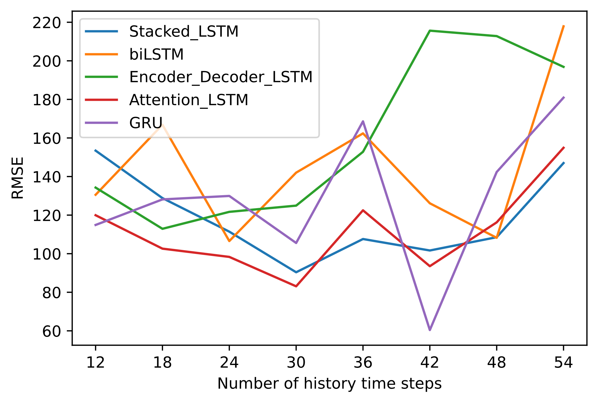
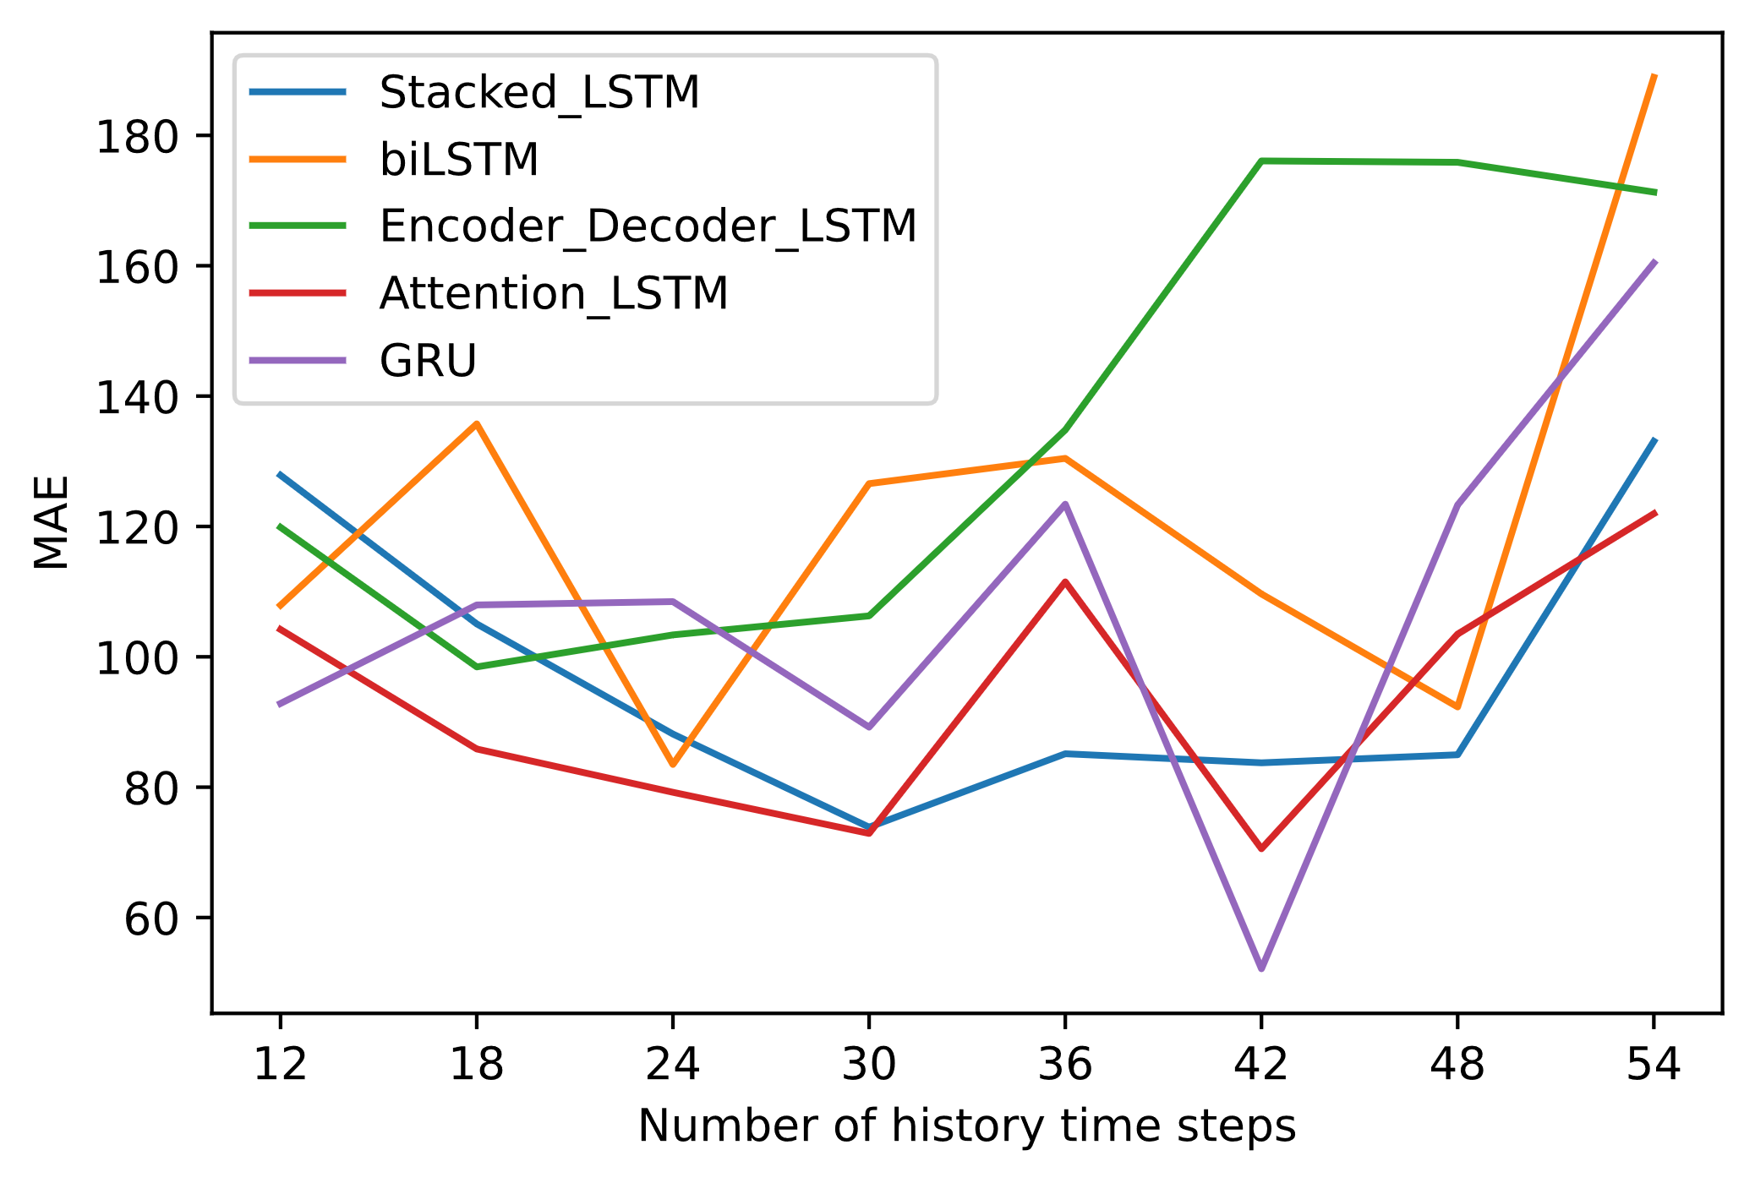
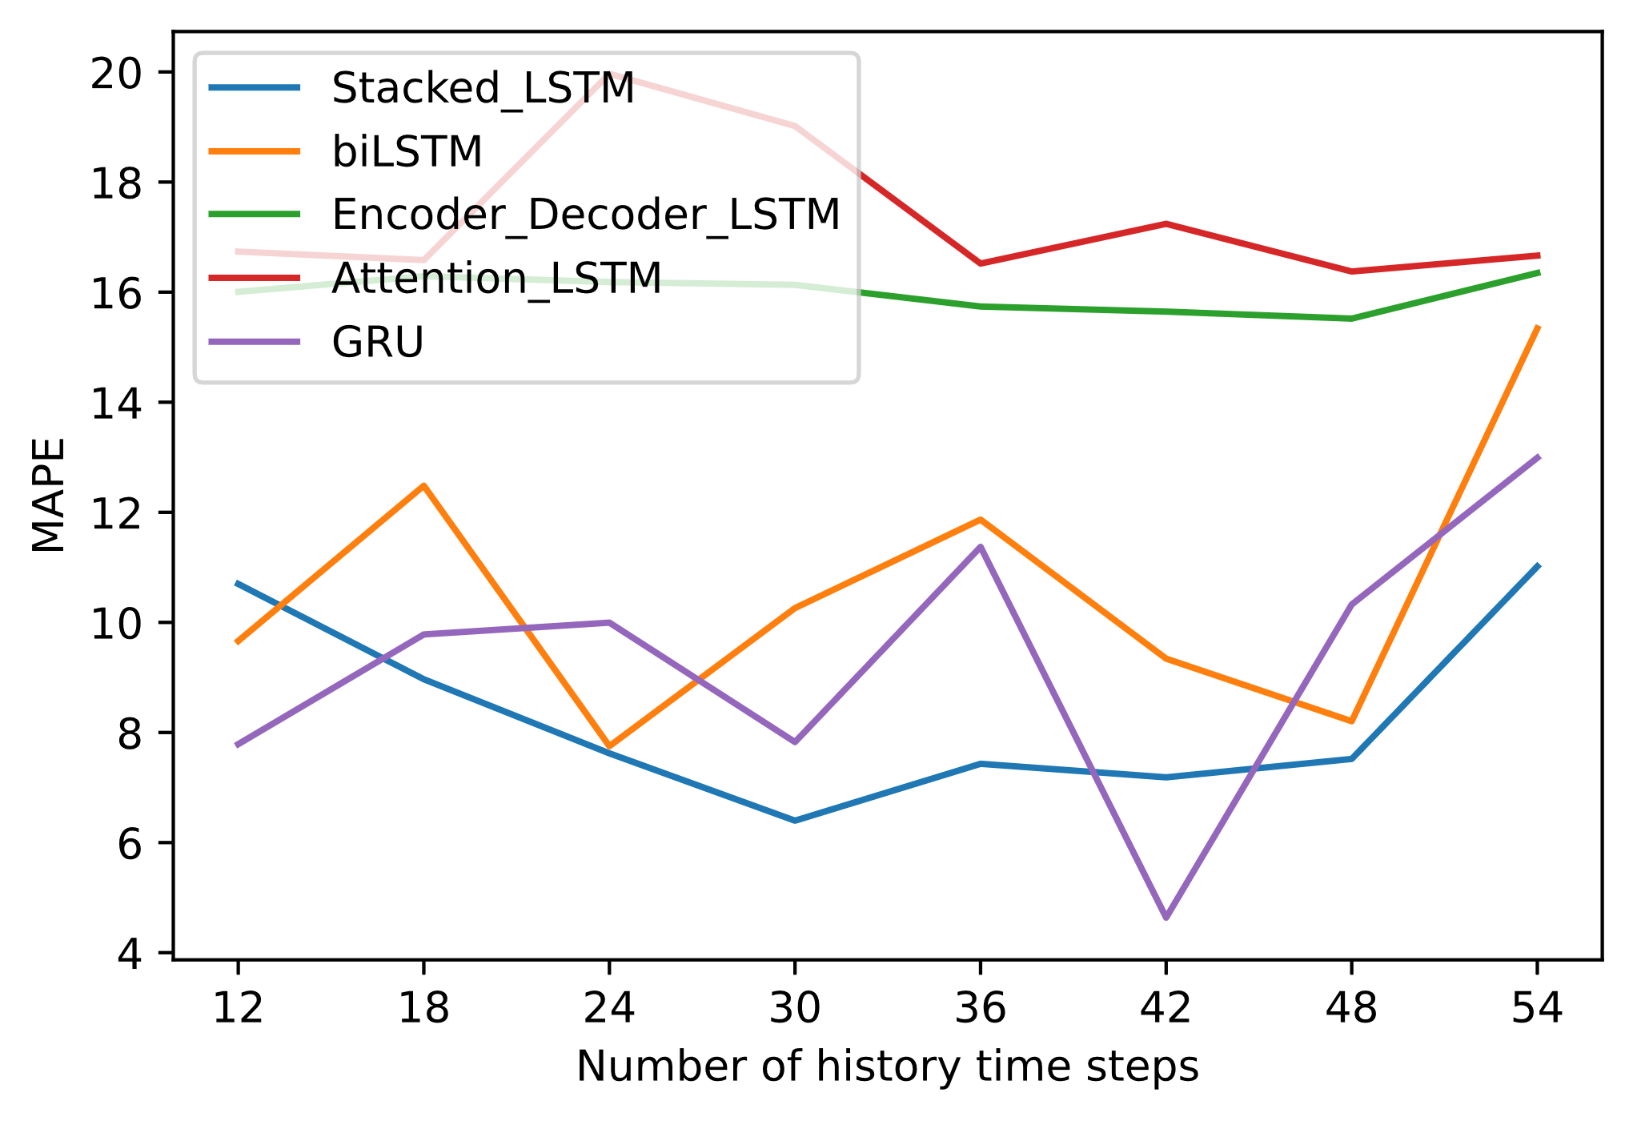
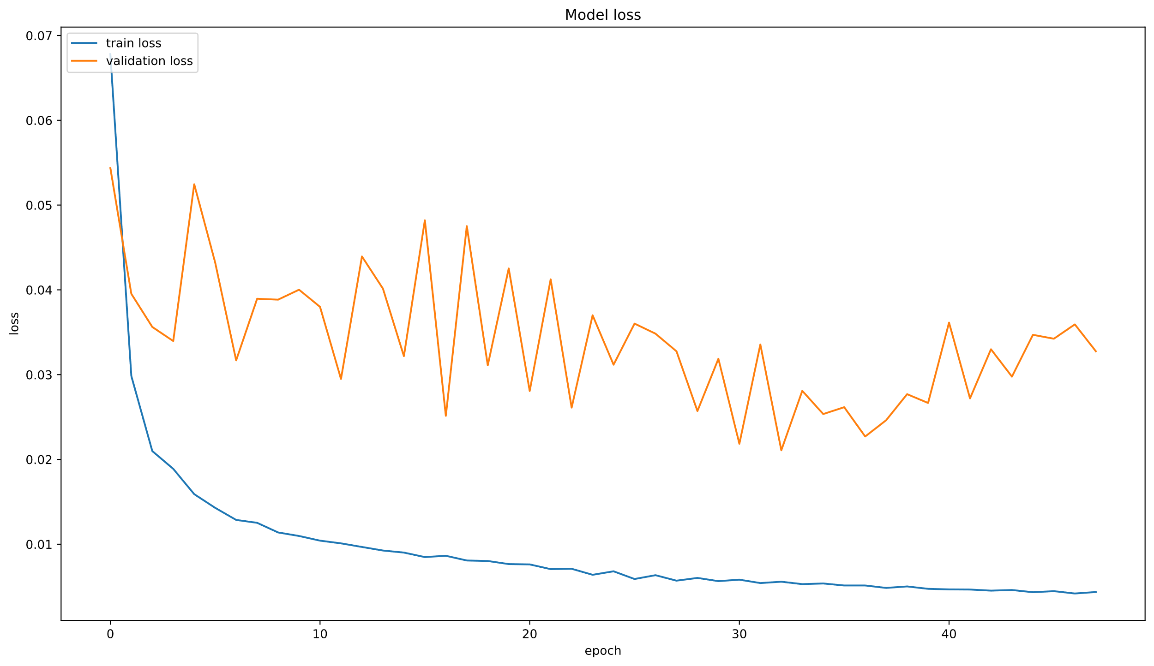
Impact of history time steps Deep Learning
Notes:
http://www.careourearth.com/wp-content/uploads/2018/02/Real-time-AQI-Visual-Map_Berkeley.jpg
https://www.iqair.com/world-air-quality-ranking
https://www.weforum.org/agenda/2016/10/air-pollution-facts/
https://www.iqair.com/world-most-polluted-cities/world-air-quality-report-2021-en.pdf
https://www.careourearth.com/real-time-air-quality-index-visual-map-excellent/
https://www.orfonline.org/expert-speak/taking-on-a-burning-problem-mumbais-air-pollution/

Slide 26
Impact of history time steps Deep Learning
Notes:
http://www.careourearth.com/wp-content/uploads/2018/02/Real-time-AQI-Visual-Map_Berkeley.jpg
https://www.iqair.com/world-air-quality-ranking
https://www.weforum.org/agenda/2016/10/air-pollution-facts/
https://www.iqair.com/world-most-polluted-cities/world-air-quality-report-2021-en.pdf
https://www.careourearth.com/real-time-air-quality-index-visual-map-excellent/
https://www.orfonline.org/expert-speak/taking-on-a-burning-problem-mumbais-air-pollution/

Slide 27
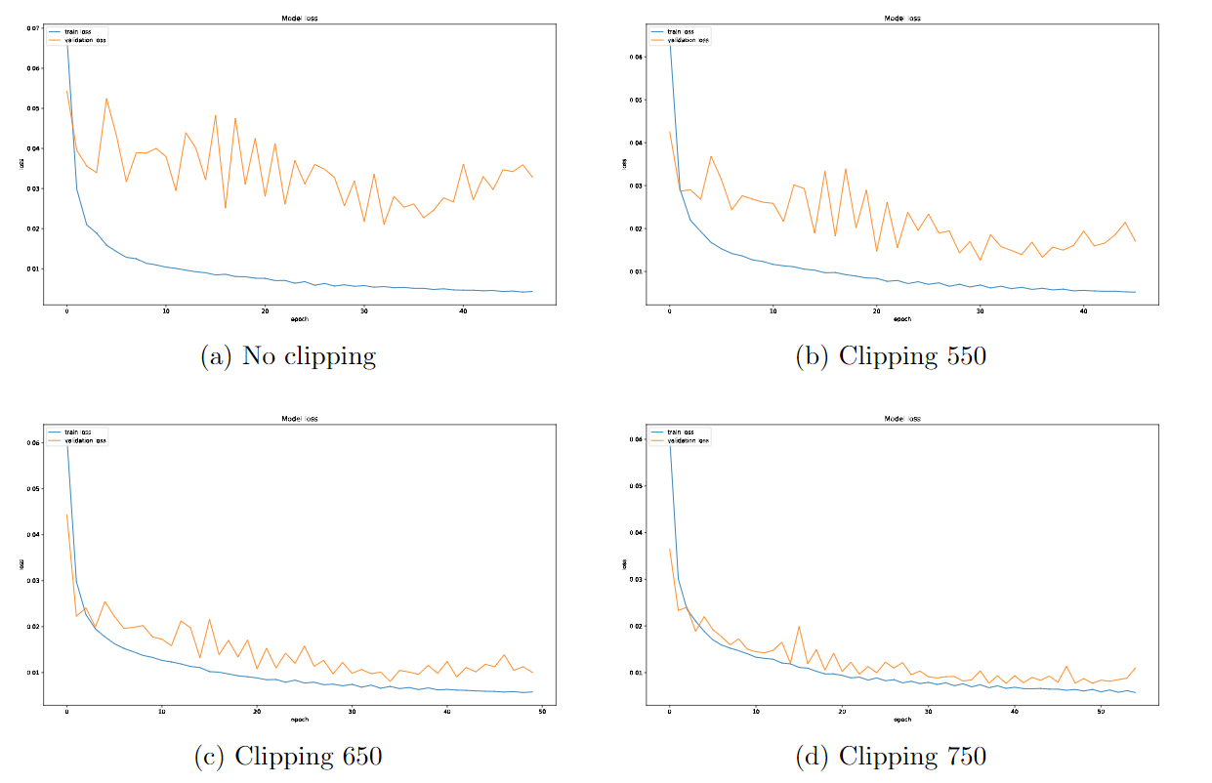
Effect of clipping technique
Notes:
http://www.careourearth.com/wp-content/uploads/2018/02/Real-time-AQI-Visual-Map_Berkeley.jpg
https://www.iqair.com/world-air-quality-ranking
https://www.weforum.org/agenda/2016/10/air-pollution-facts/
https://www.iqair.com/world-most-polluted-cities/world-air-quality-report-2021-en.pdf
https://www.careourearth.com/real-time-air-quality-index-visual-map-excellent/
https://www.orfonline.org/expert-speak/taking-on-a-burning-problem-mumbais-air-pollution/

Slide 28
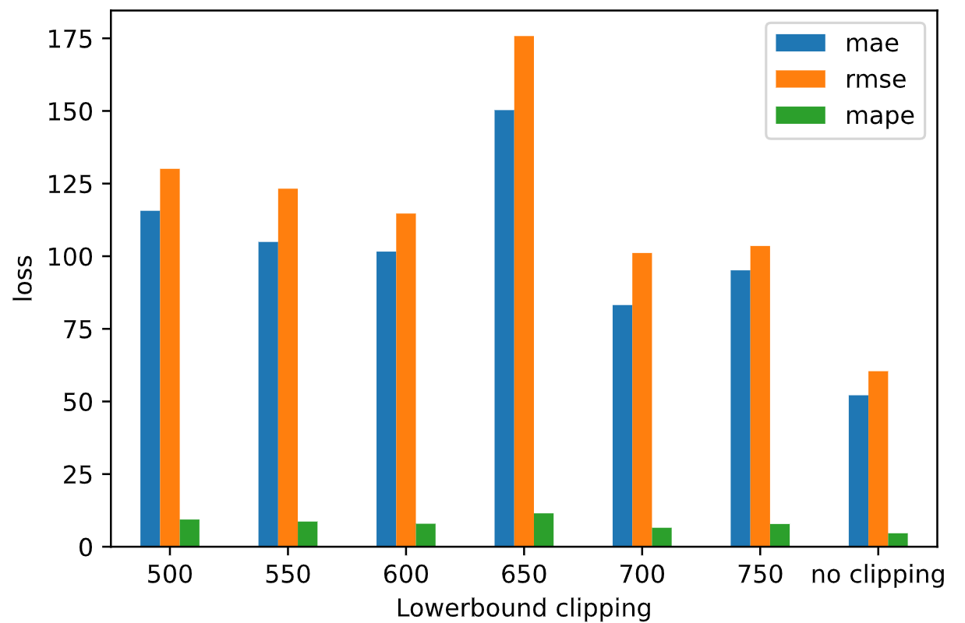
Effect of clipping technique
Notes:
http://www.careourearth.com/wp-content/uploads/2018/02/Real-time-AQI-Visual-Map_Berkeley.jpg
https://www.iqair.com/world-air-quality-ranking
https://www.weforum.org/agenda/2016/10/air-pollution-facts/
https://www.iqair.com/world-most-polluted-cities/world-air-quality-report-2021-en.pdf
https://www.careourearth.com/real-time-air-quality-index-visual-map-excellent/
https://www.orfonline.org/expert-speak/taking-on-a-burning-problem-mumbais-air-pollution/

Slide 29
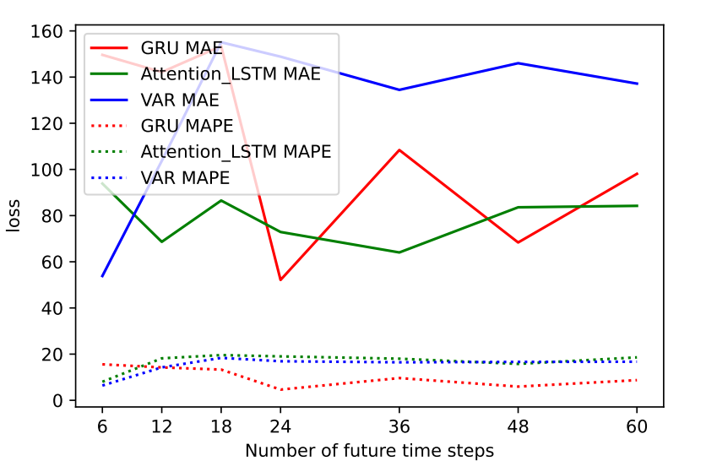
Impact future time steps
Notes:
http://www.careourearth.com/wp-content/uploads/2018/02/Real-time-AQI-Visual-Map_Berkeley.jpg
https://www.iqair.com/world-air-quality-ranking
https://www.weforum.org/agenda/2016/10/air-pollution-facts/
https://www.iqair.com/world-most-polluted-cities/world-air-quality-report-2021-en.pdf
https://www.careourearth.com/real-time-air-quality-index-visual-map-excellent/
https://www.orfonline.org/expert-speak/taking-on-a-burning-problem-mumbais-air-pollution/

Slide 30
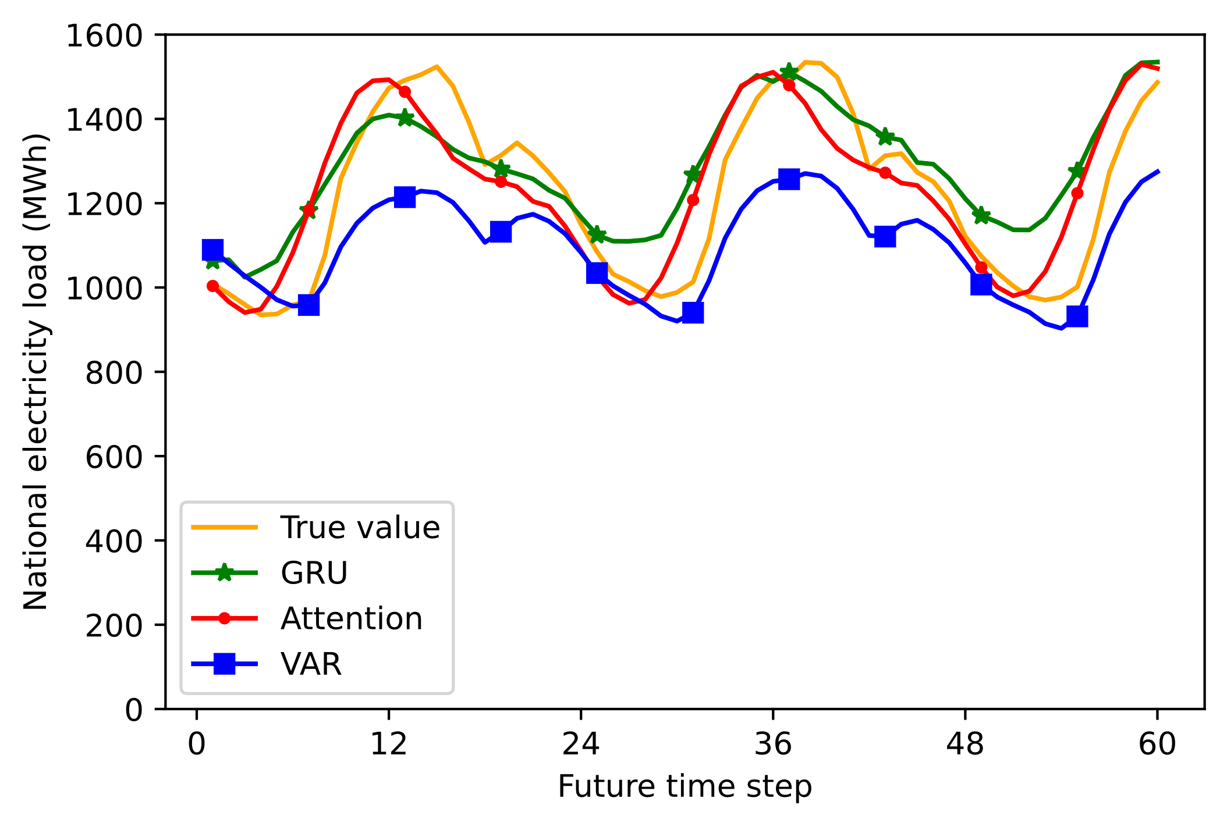
Forecast vs Actual
Notes:
http://www.careourearth.com/wp-content/uploads/2018/02/Real-time-AQI-Visual-Map_Berkeley.jpg
https://www.iqair.com/world-air-quality-ranking
https://www.weforum.org/agenda/2016/10/air-pollution-facts/
https://www.iqair.com/world-most-polluted-cities/world-air-quality-report-2021-en.pdf
https://www.careourearth.com/real-time-air-quality-index-visual-map-excellent/
https://www.orfonline.org/expert-speak/taking-on-a-burning-problem-mumbais-air-pollution/

Slide 31
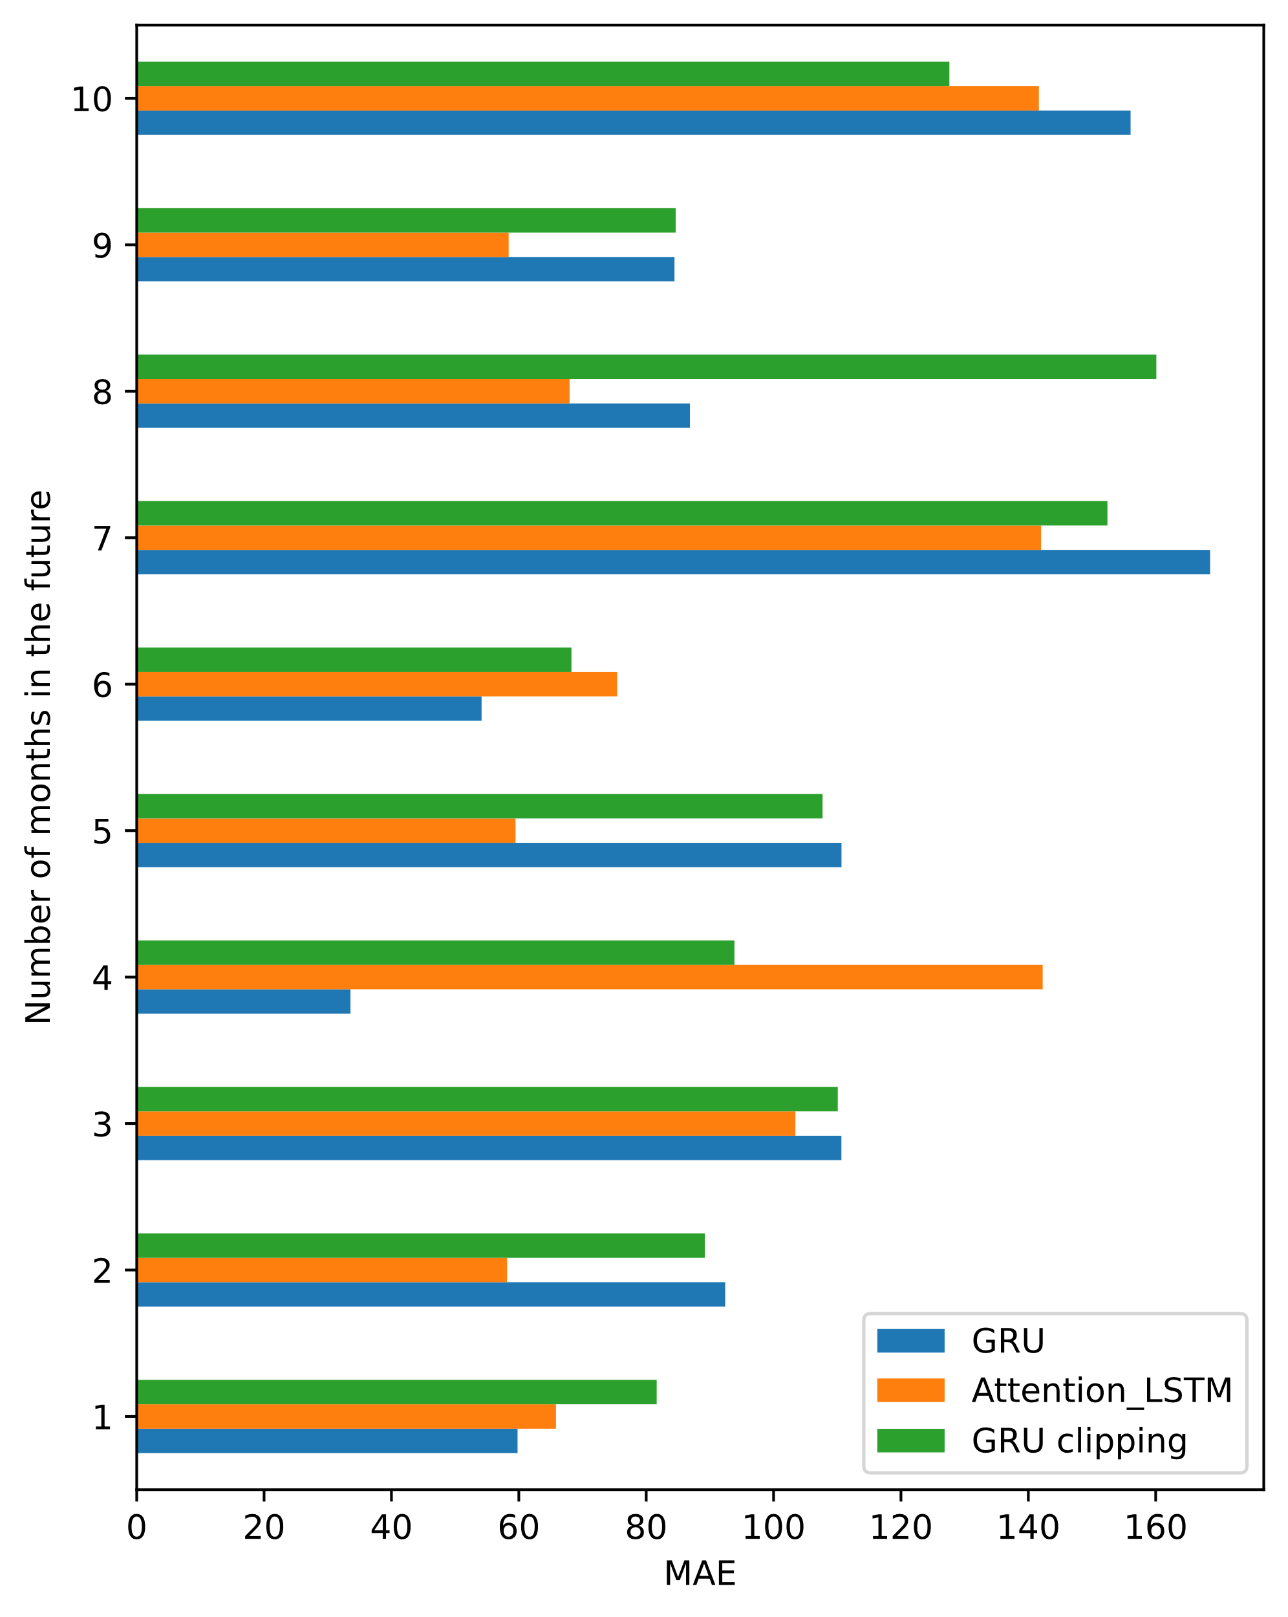
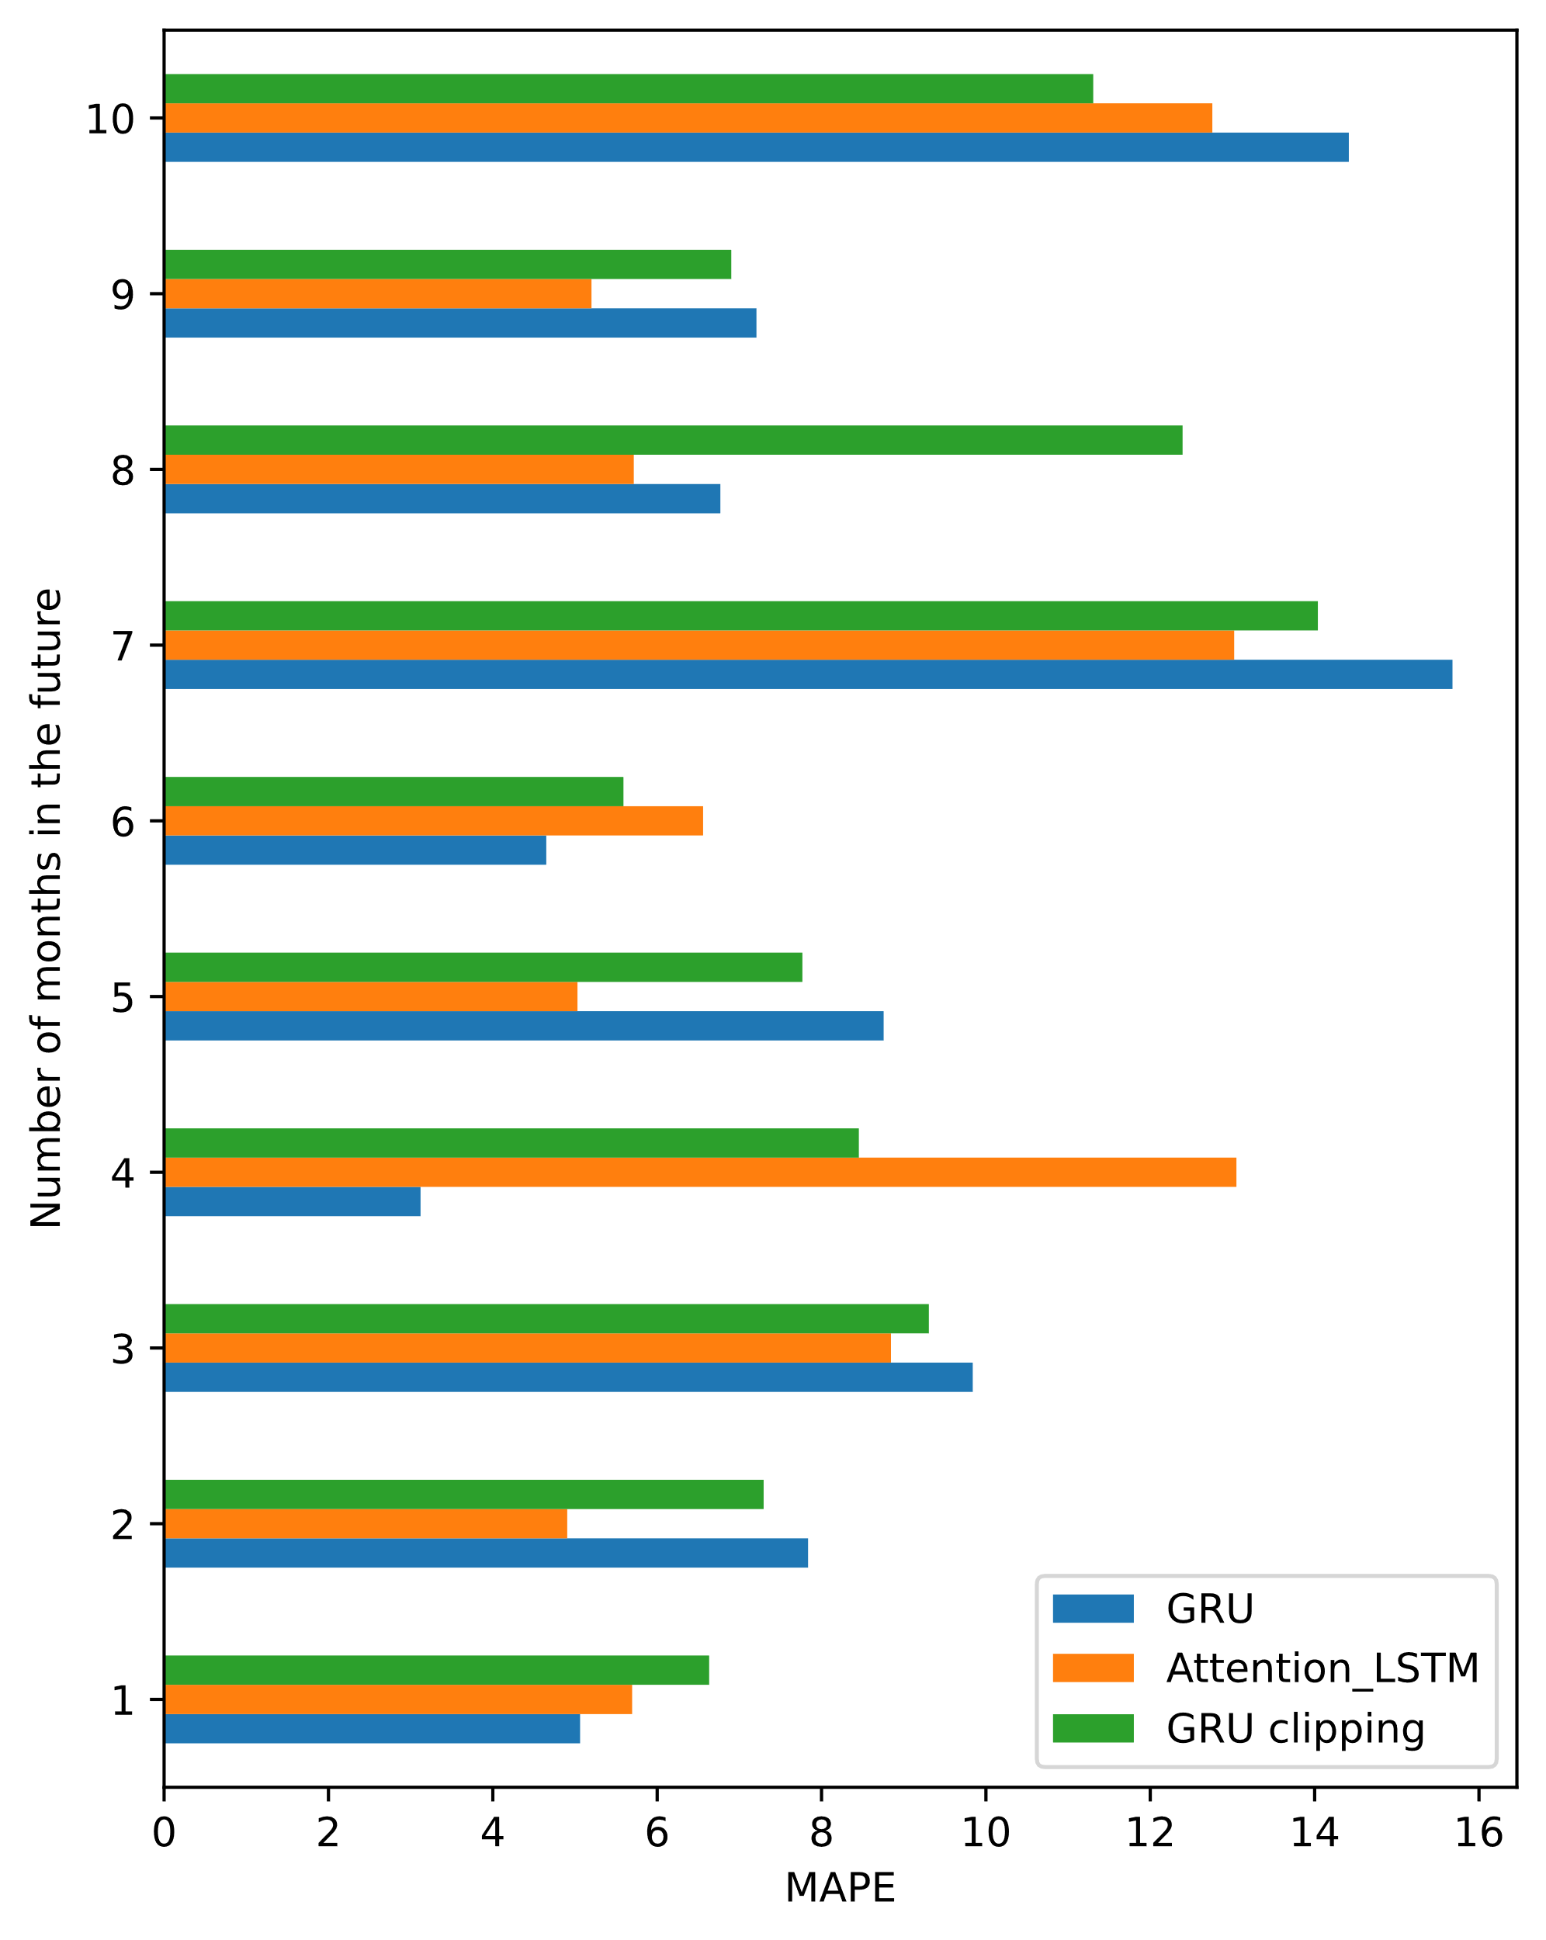
Endurance of Deep Learning models
Notes:
http://www.careourearth.com/wp-content/uploads/2018/02/Real-time-AQI-Visual-Map_Berkeley.jpg
https://www.iqair.com/world-air-quality-ranking
https://www.weforum.org/agenda/2016/10/air-pollution-facts/
https://www.iqair.com/world-most-polluted-cities/world-air-quality-report-2021-en.pdf
https://www.careourearth.com/real-time-air-quality-index-visual-map-excellent/
https://www.orfonline.org/expert-speak/taking-on-a-burning-problem-mumbais-air-pollution/

Slide 32
Contents
Problem
Data
Models
Experiments
Conclusion

Slide 33
Conclusion
In this project, we have:
Studied about different machine learning models for multivariate time-series problem.
Built experimental scenarios to test the performance of different approaches in a multivariate time-series problem.
Implication:
Deep Learning models have better performance than traditional approaches like VAR and Facebook Prophet when forecasting a long-term period.
Thanks to training a large and seasonal dataset, deep learning models have a high endurance.

Slide 34
Contributors
Ta Huu Binh: Write source code of all models, design test scenarios, visualize results, evaluate model performance.
Tran Trong Hiep
Research, install and experimental run LSTM, Stacked LSTM, BiLSTM model.
Research loss functions (MAE, RMSE, MAPE).
Evaluate performance and compare to other models.
Ha Duc Tuan: Research, install and experimental run FacebookProphet, Auto-encoder LSTM.
Nguyen Van Trung: Research, install and experimental run VAR, Attention LSTM, GRU model.

Slide 35
THANK YOU !

